Slide 1
THE STREETFEAST
EXPRESS
AASHIKA AJITH(22CSC01)
LAVANYA.A(22CSC27)

Slide 2

OUR COMPANY
THE STREETFEAST EXPRESS
A food truck which offers delicious and mouthwatering foods and beverages to the people who loves the food. They can either come directly to the truck and eat or they can order through our website.

Slide 3
ABOUT THE WEBSITE
People can use our website to know more about us as we clearly described what our website is, in the home page. They can view our menu and they can know our location as we provided them our address and shared our location. If they want to order the food online they must sign up/register into our website. Once they signed in, they can login whenever they want and can order their desired foods. After they added the food items to the cart, they can either increase or decrease the quantity or they can remove that item if they feel they no longer need that. Once they confirmed the items they can place the order and it will take them to the payment page where they need to provide their card details and they can pay. Finally they will receive the mail saying thanks for ordering the food from our food truck.

Slide 4
WHAT WE WORKED ON
SECURE
ACCESSIBLE
FAST AND RELIABLE
we prioritize the security of your information. All details collected on this website are treated with the utmost confidentiality and are safeguarded through secure data encryption
Accessibility is a core principle of our website design. We are committed to ensuring that everyone, regardless of abilities or disabilities, can easily access and navigate our site.
Our website is optimized for speed, ensuring swift loading times and seamless navigation. With continuous monitoring, we guarantee a reliable platform that's available whenever you need it

Slide 5
OUR GOALS
EXPANSION
POSITIONING
USABILITY
We're growing! Our plans include expanding our reach and offerings to better serve you. Stay tuned for exciting developments as we broaden our horizons and bring more value to our community
We understand our competition, and showcase what makes us unique. By standing out, we attract and engage our target audience, leaving a lasting impression in the digital world
We prioritize creating an intuitive and user-friendly experience, ensuring that visitors can effortlessly navigate our website

Slide 6
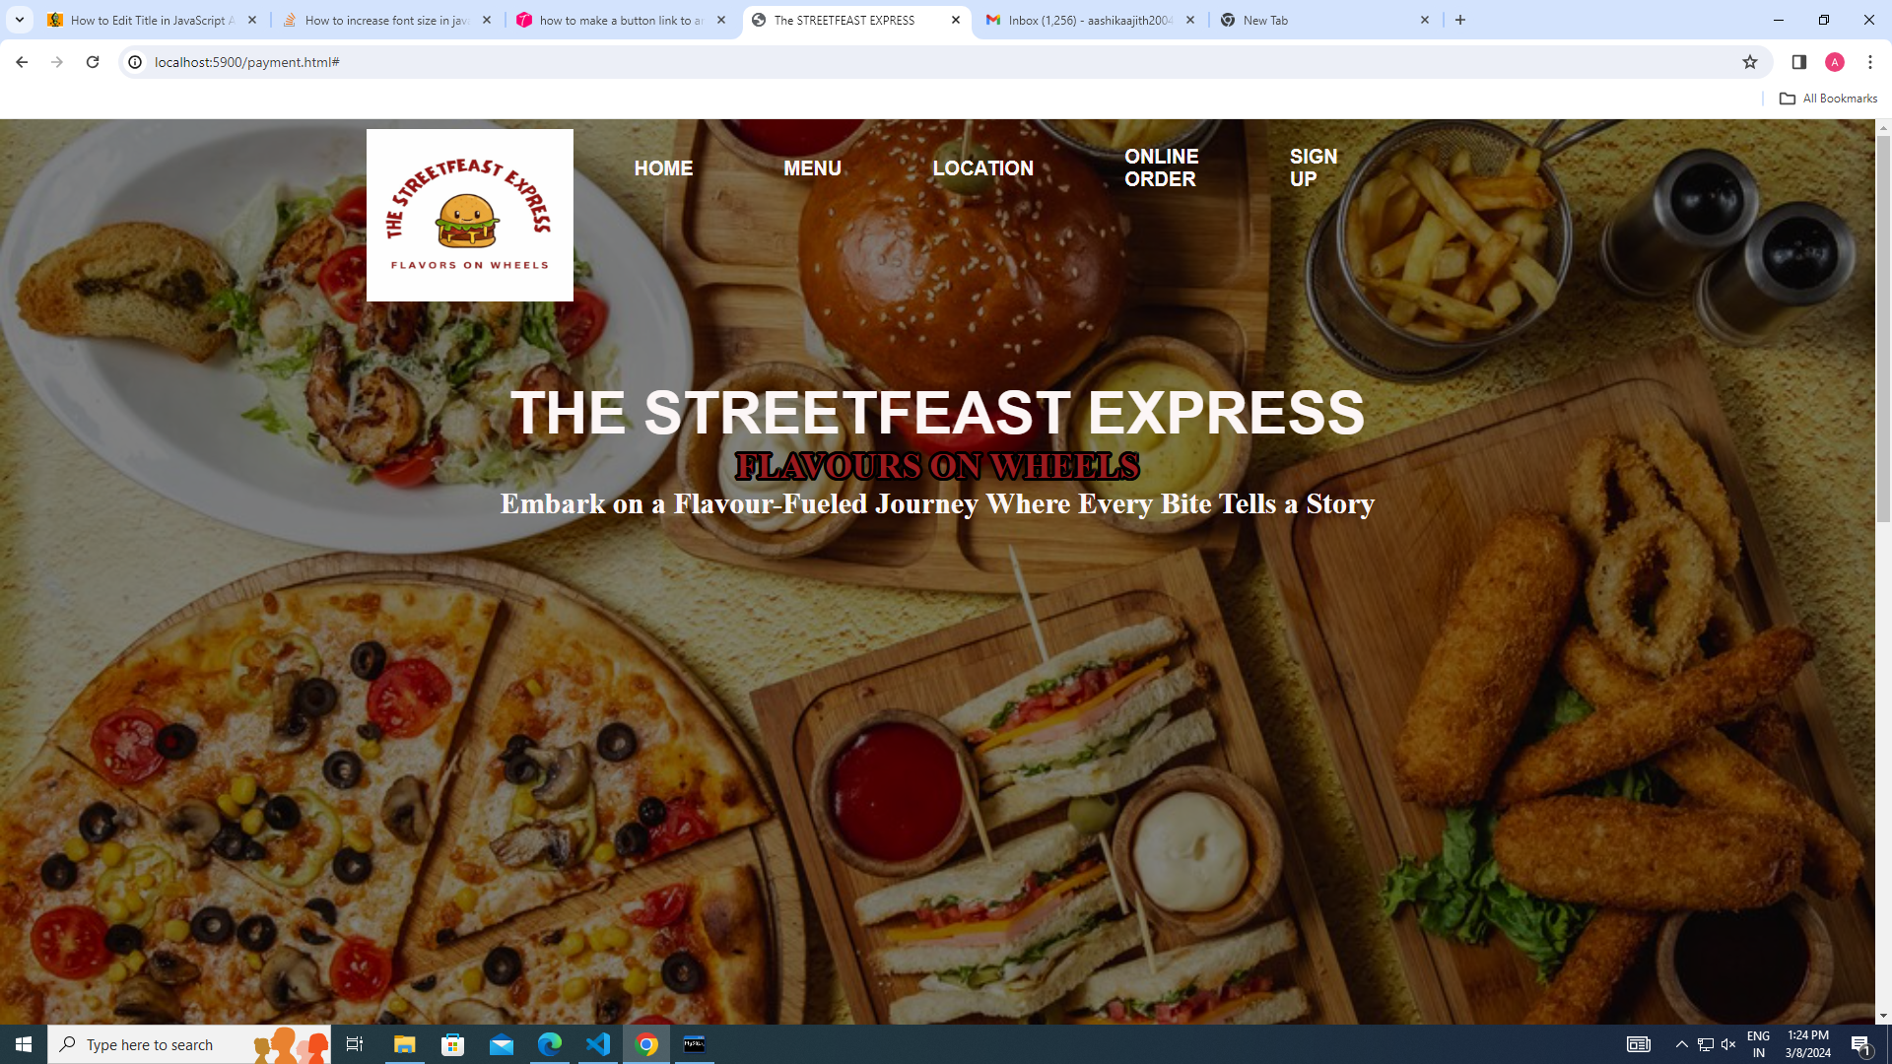
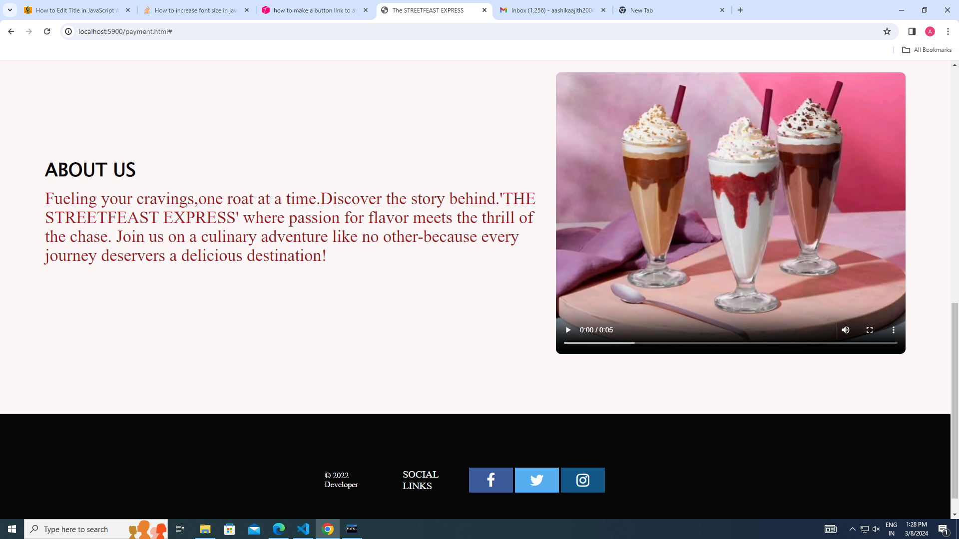
HOME PAGE
This is our homepage, it contains information about us. If people or our costumers need to know more about us they can verify this page.
We have also given our social media accounts down the homepage so people can contact us.
They can also tag us on Instagram so more people get to know about our food truck.

Slide 7
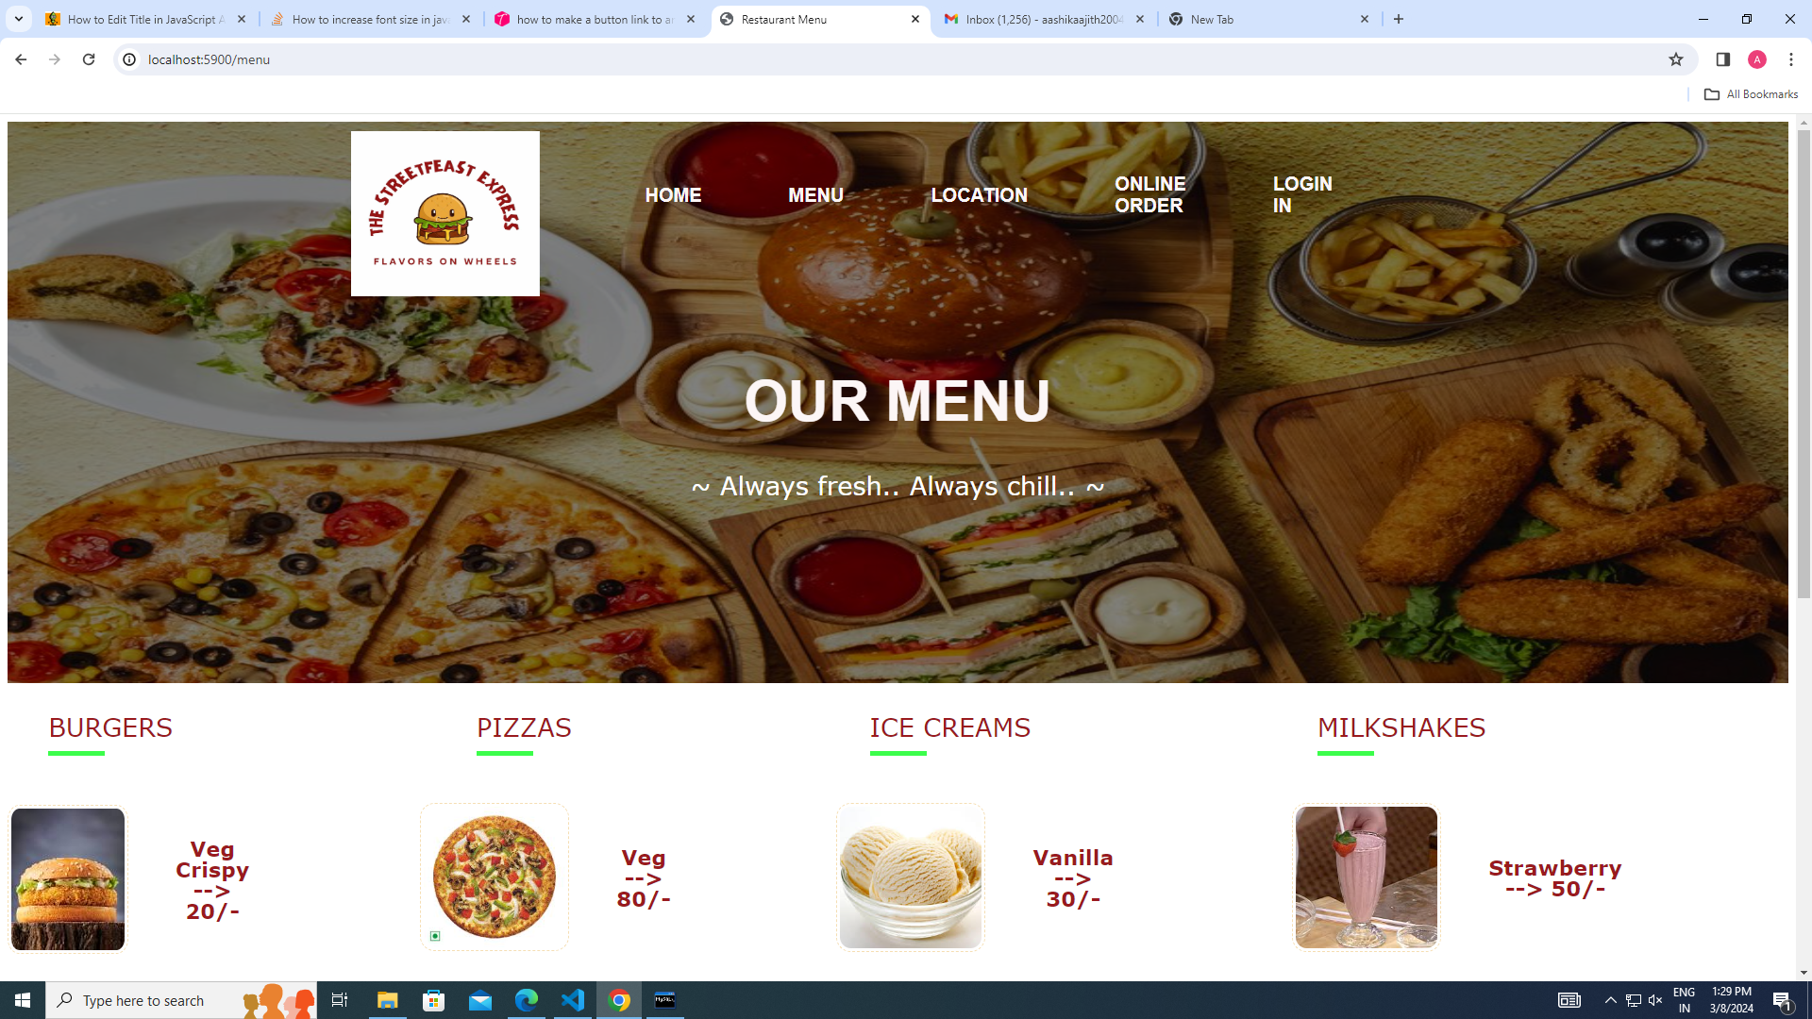
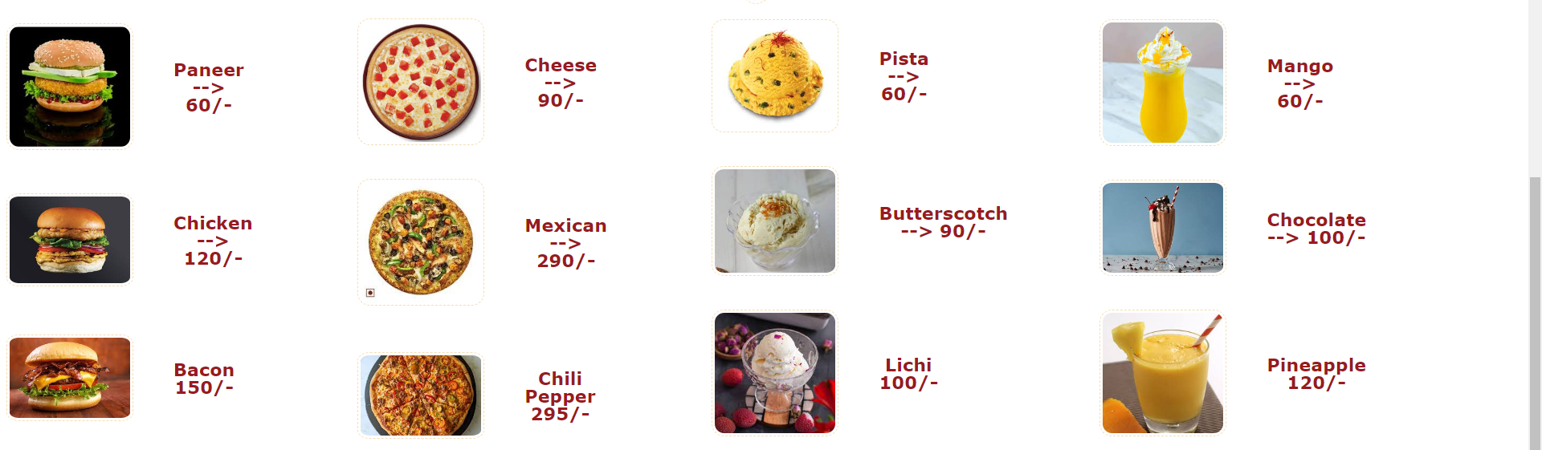
MENU PAGE
This is our menu page. Here people can see our menu items and their prices .
This will help the user to plan on their budget before they order.
This wont cause money related problem for our dear customers.

Slide 8
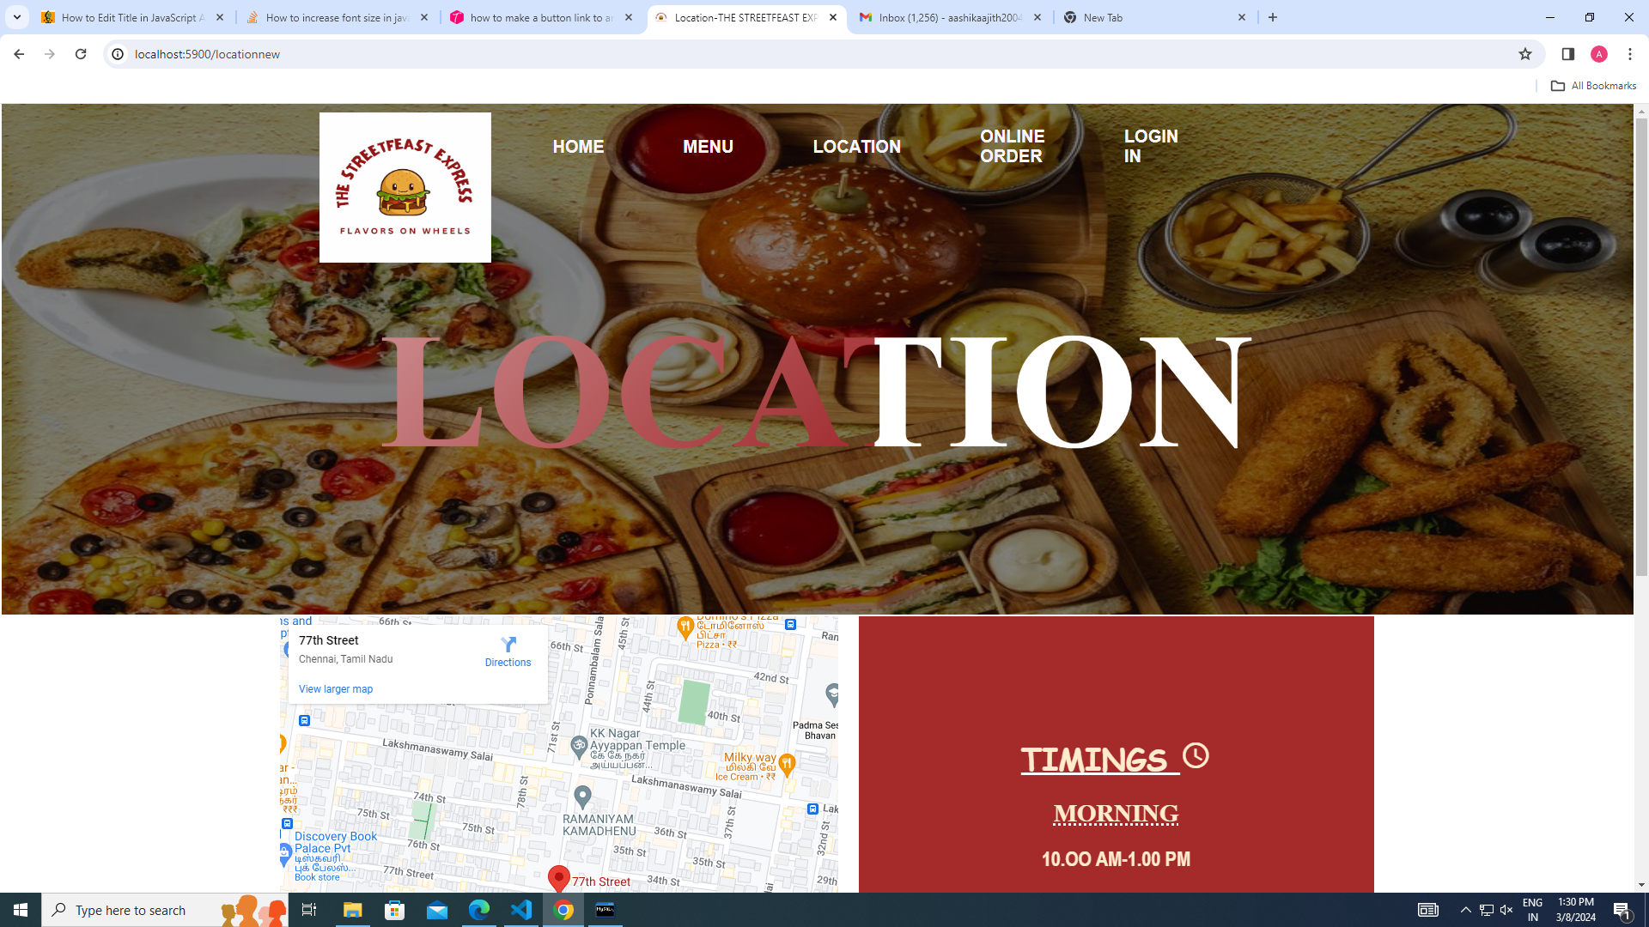
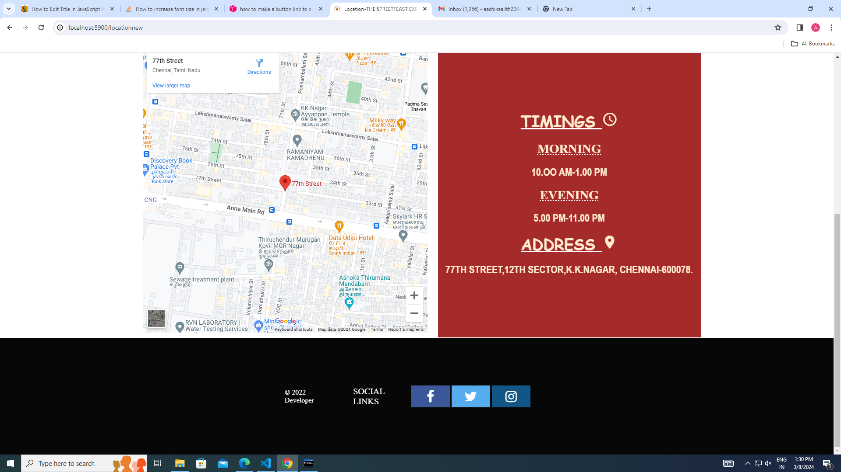
LOCATION
The location page enable the users to know where the food truck is.
It contains the google map which facilitate user to know our direct location.
It also contains timings of the food truck.

Slide 9
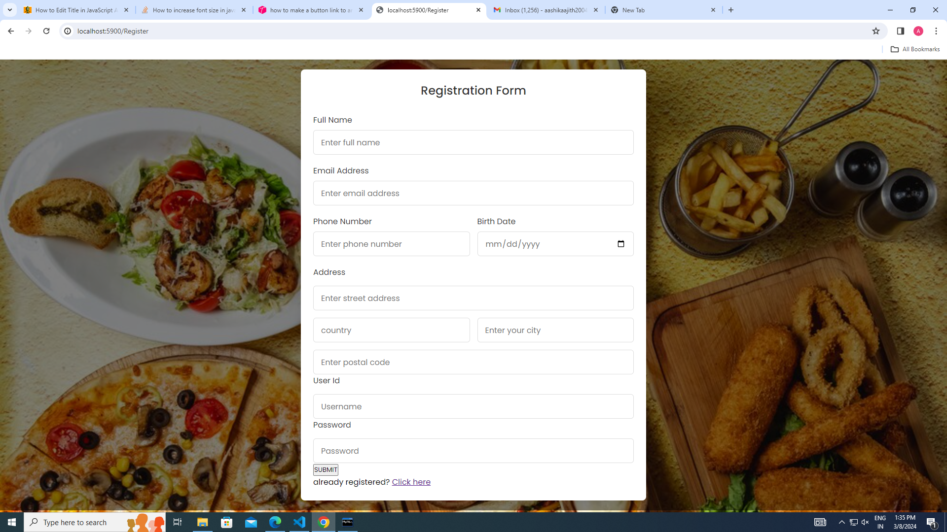
REGISTRATION
In this page, the users has to enter their details to sign up into our website.
All the details are mandatory
If the username that they enter is already exist then they cannot have that.
Password must be maximum of 8 characters and they include capital letters and numbers
These details will be kept confidential

Slide 10
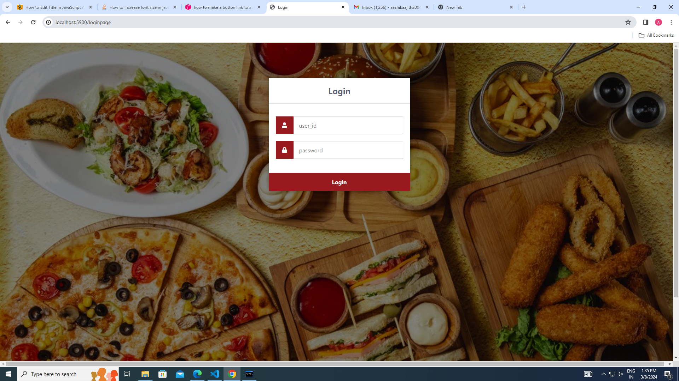
LOGIN PAGE
Once the users are registered in our website , they can enter their username and password to login into our website whenever they open.
This enable the people to place order through online

Slide 11
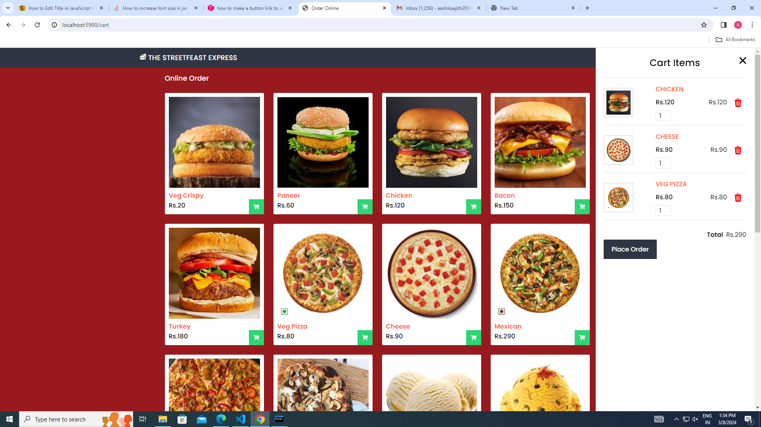
ONLINE ORDER
This is the page where the users can buy the food that they want.
They can increase or decrease the quantity or they can delete the item from cart
Once they decided the items and put it in the cart, they can place order .
If they press place order, it will take them to a payment page where the users can put their card details and they can pay.

Slide 12
Thank you for your time and attention.
Gratitude for Your Attention !

